Slide 1
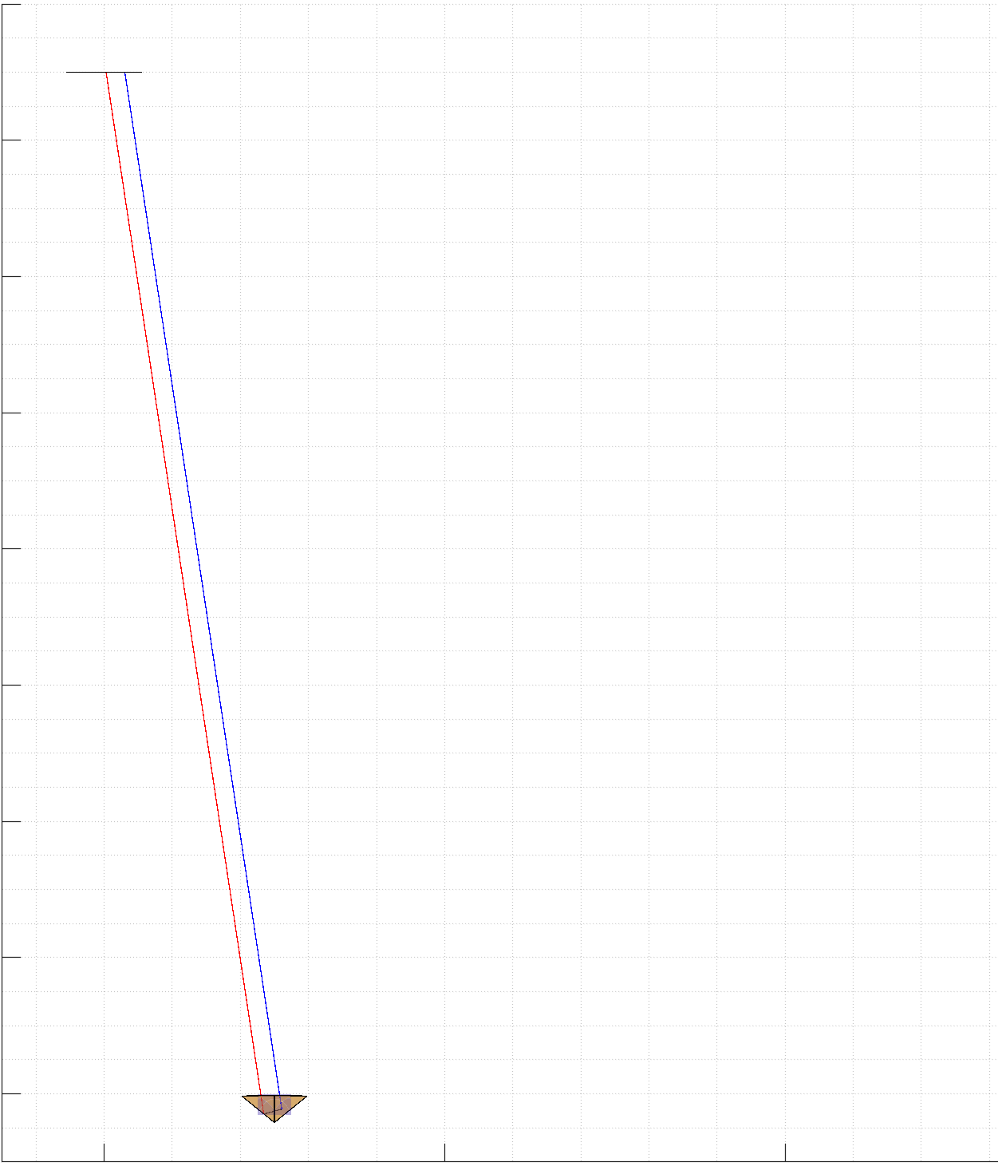
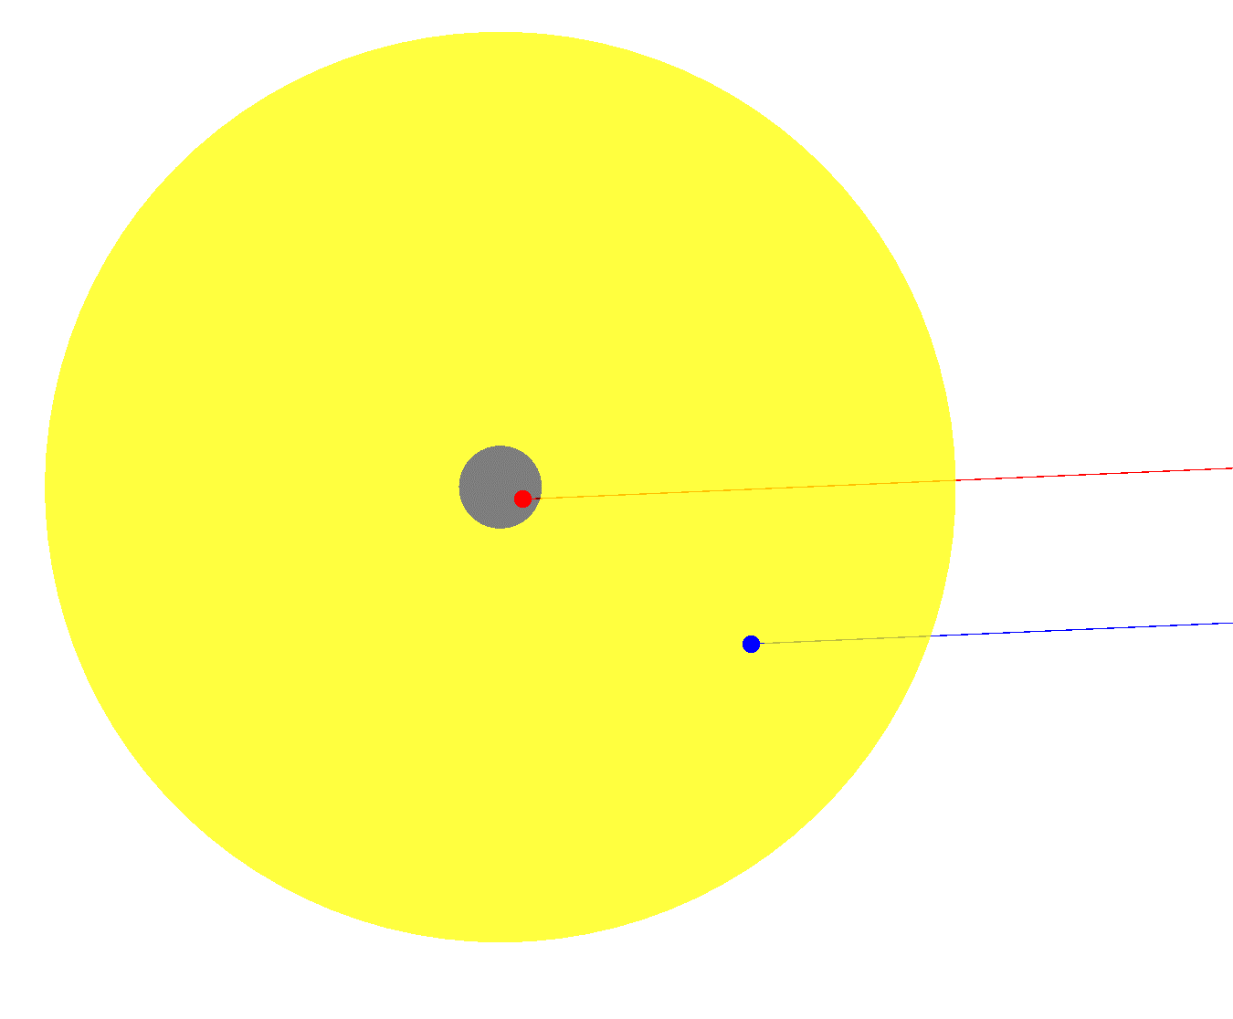
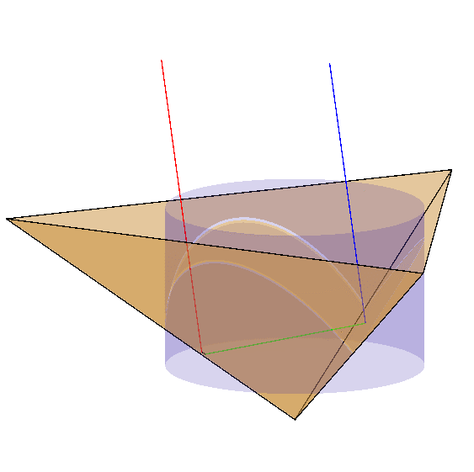


Light Plane (Top View)
Return Ray
Initial Ray
$$z$$
$$x$$

Slide 2
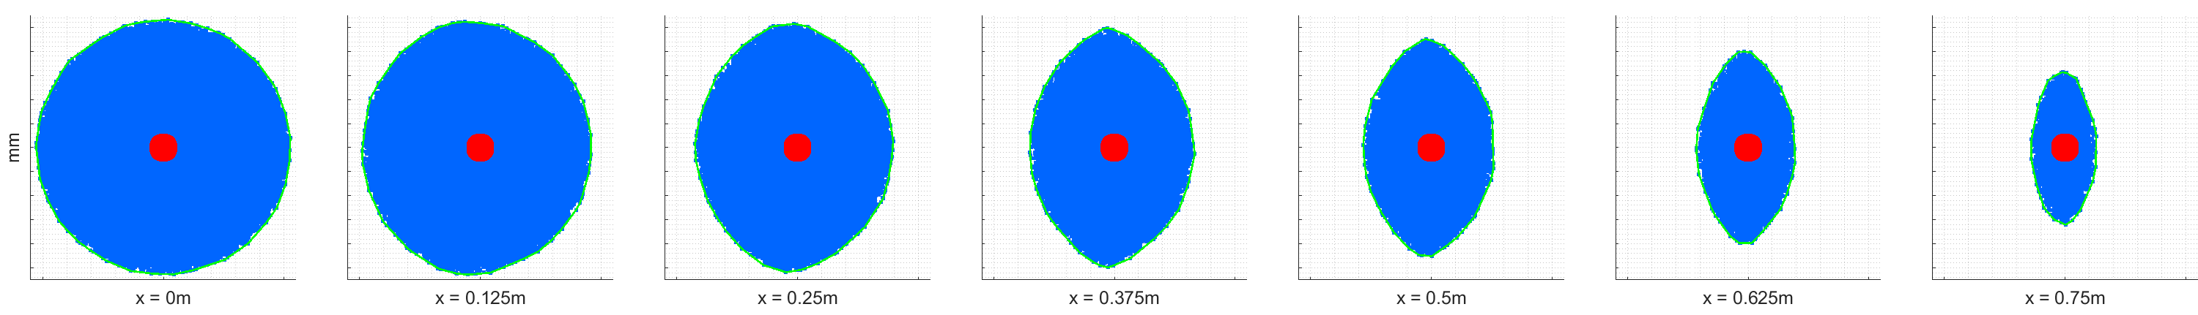
Ø50mm
Ø10mm

Slide 3
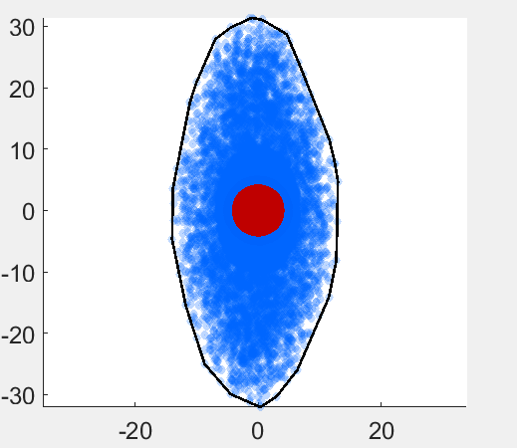
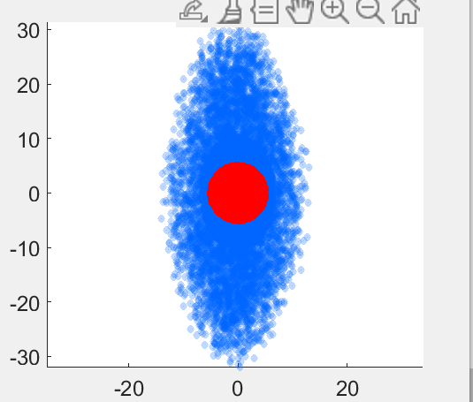
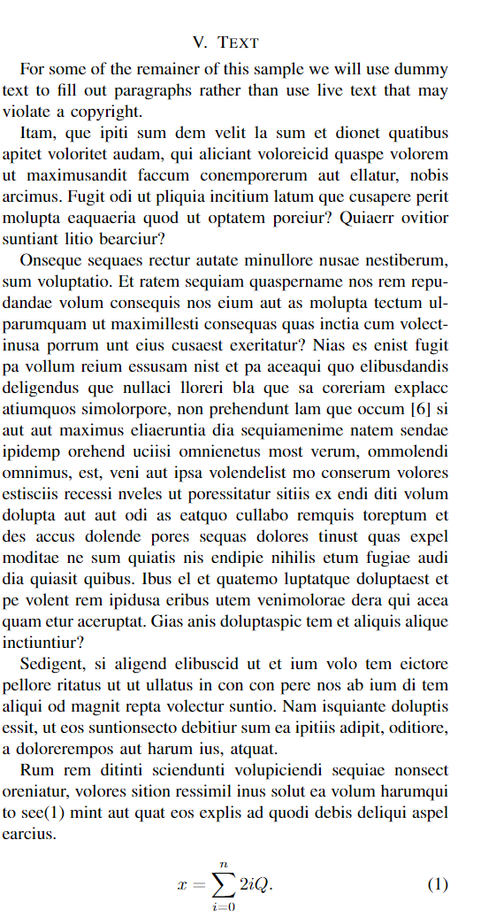
Fig. 1 (a) The progression of ERA as horizontal displacement increases. (b) A render of the simulation setup for v=.25m. (c) A closeup of the corner cube retroreflector, the blue segment is an incident ray, while the red segment is its reflection.

